Slide 1
Child & Dependent Care Credit
Pub 17 Chapters 3 & 32
Pub 4012 Tab G
(Federal 1040-Line 49)
Notes:
1

Slide 2
Child & Dependent Care Credit – 1040 Line 49
Can deduct portion of child care expenses if:
Pay for care in order to work or look for work
Have a qualifying person
Only custodial parent may claim, even if non-custodial parent can claim exemption under rules for divorced & separated parents
Credit can be 20% to 35% of expenses, based on earned income & AGI
Nonrefundable credit
Use Form 2441 to calculate credit
Notes:
Maximum Child and Dependent care expenses that can be claimed for 2014 is $3,000 for one person cared for, or $6,000 for more than one person cared for. The Child & Dependent care credit is a percentage of expenses claimed.
2

Slide 3
Requirements for Child & Dependent Care Credit
Pub 4012 Tab G
Taxpayer must pass 5 tests to claim:
Qualifying Person Test
Earned Income Test
Work-Related Expense Test
Joint Return Test
Provider Identification Test
Use Decision Tree, Pub 4012 Page G-4
Notes:
3

Slide 4
Child & Dependent Care Credit: Qualifying Person Test
Child who was under age 13 when expenses were incurred and who can be claimed as dependent
Your disabled spouse incapable of self-care
Any other person incapable of self-care and
Can be claimed as your dependent OR
Would have qualified as your dependent except:
his income exceeded $3,950
he filed a joint return
Taxpayer/spouse could be claimed as dependent on another return
Notes:
4

Slide 5
Child & Dependent Care Credit: Qualifying Person Test
(cont’d)
Qualifying person must live with taxpayer > ½ year
Taxpayer does not have to pay over half the cost of keeping up a home for the qualifying person
If Dependent Care Benefits are listed on W-2 Box 10, must complete Form 2441. Otherwise, benefits count as taxable wages
Notes:
5

Slide 6
Child/Dependent Care Credit: Earned Income Test
Taxpayer (& spouse) must have earned income – wages, tips, &/or net self-employment
Spouse treated as having earned income if full-time student or disabled
Notes:
6

Slide 7
Child/Dependent Care Credit: Work-Related Expense Test
To qualify for credit, expenses must:
Allow taxpayer (& spouse) to work or look for work
Be for a qualifying person’s care
NOT be for food, clothing, education & entertainment
NOT be for attending kindergarten or higher grade
Notes:
7

Slide 8
Expenses That Do Not Qualify as Work-Related
Education expenses to attend kindergarten or higher grade
The cost of sending child to an overnight camp
The cost of day camp may count
The cost of transporting a qualifying person from the taxpayer’s home to the care location & back
Notes:
8

Slide 9
Child/Dependent Care Credit: Joint Return Test
Generally, married couples who wish to take the child & dependent care credit must file a joint return.
However, an allowable exception are taxpayers who are considered unmarried if they file a separate return and:
are legally separated on the last day of tax year (Single), OR
lived apart from their spouse for the last 6 months of the year & paid more than half the cost of providing a home which was also the main home of the qualifying person for more than half the year (HOH)
Notes:
9

Slide 10
Child/Dependent Care Credit Provider Identification Test
Must have Provider Identification info
Form W-10 “Dependent Care Provider ID & Certification”
Social Security card
If provider is household employee, need copy of provider’s W-4
Must show due diligence if no ID
Payments to your own children under age 19 do not qualify
Notes:
10

Slide 11
Employer-Provided Child/ Dependent Care Benefits
Check W-2’s carefully for Dependent Care Benefits (DCB) – amount is shown in Box 10
If Taxpayer receives Dependent Care Benefits from employer, complete Page 2 of Form 2441
Overall qualified expense limit of $3,000/$6,000 is reduced, dollar for dollar, by any reimbursement excluded from taxpayer’s income
Notes:
11

Slide 12
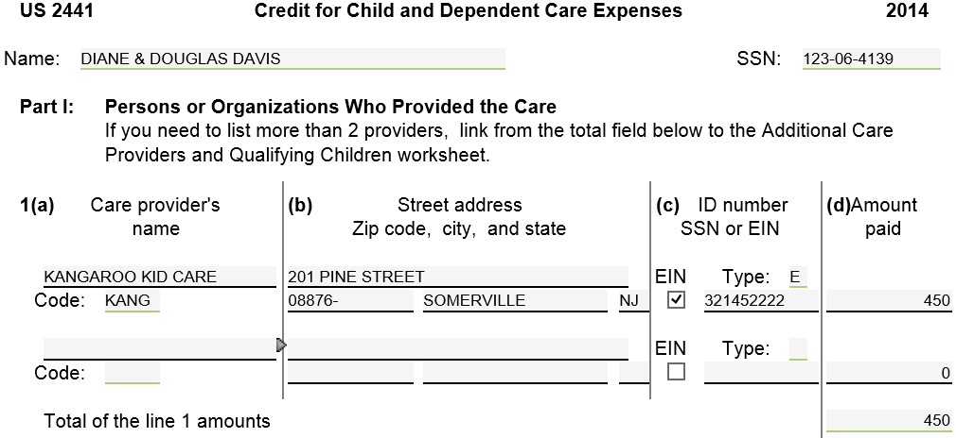
TW-Child/Dependent Care Expenses – Form 2441 – Part I
2014
Notes:
If DC box is checked on Main Info screen, TW will insert a Form 2441 Credit for Child & Dependent Care Expenses in Forms Tree
Open form 2441 part I
Enter info on Child Care provider(s) on Line 1a & Amount Paid
TW will calculate total paid for child care for Line 1a
Complete Lines 2a, b, c for each qualifying person
TW will calculate allowable Child/Dependent Care credit & transfer to 1040 Page 2 Line 49
12

Slide 13
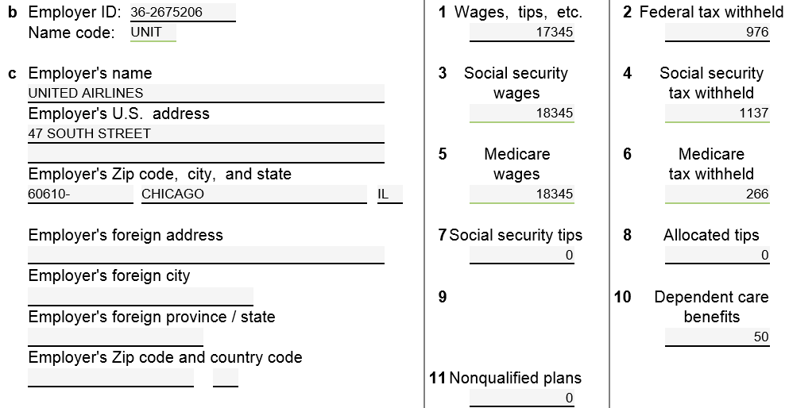
Dependent Care Benefits from Employer – W-2 Box 10
Notes:
Box 10 from W-2 could contain the amount employer paid or incurred for the employee’s Dependent Care
13

Slide 14
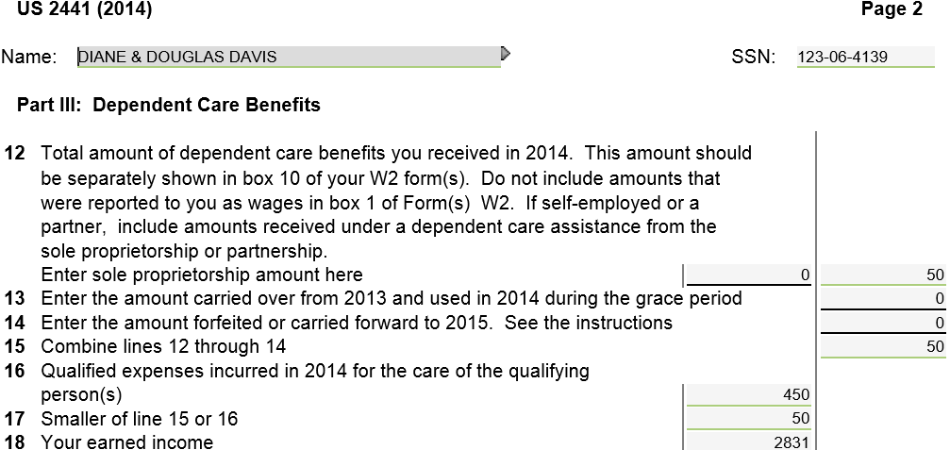
Child/Dependent Care Expenses – Form 2441 – Part III
TW gets from W-2 Box 10
Notes:
Complete Part III and II on Form 2441, only if taxpayer receives Dependent Care Benefits from employer, per Box 10 of W-2
TW calculates new Child/Dependent Care Credit by subtracting the amount received from employer from eligible child/dependent care expenses, (subject to max DC Credit)
14

Slide 15
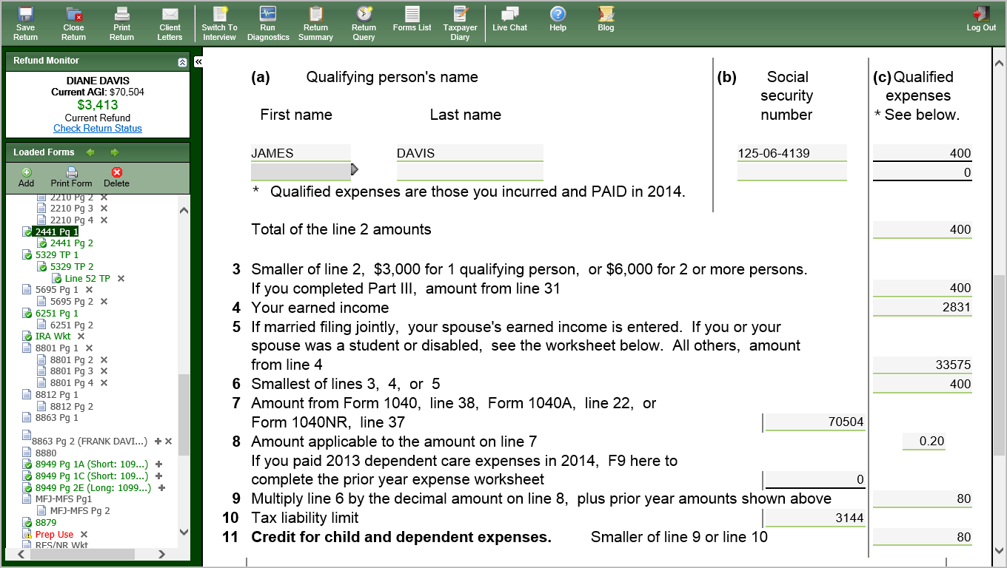
Child/Dependent Care Expenses – Form 2441 – Part II
Enter Child Care Expenses
minus Child Care Benefit
TW calculated credit
Notes:
Enter the amount of expenses not excluded on Form 2441 Page 2 on Page 1 Line 2a
You entered the full amount you paid on Line 1a
TW populated the amount you received from your employer for child care benefits (from W-2 Box 10) on Page 2 Line 12
TW then calculates the amount of expenses not excluded & shows you that amount on Page 1 Line 2
That amount is what you should enter on Line 2a
TW will transfer the Child/Dependent Care amount from Part III (after subtracting the Dependent Care Benefit received from employer) to Part II Line 3. It will then calculate appropriate Child/Dependent Care Credit
TW will transfer the credit to 1040 Line 49
15

Slide 16
Child/Dependent Care Credit – Federal 1040 Line 49
TW transfers from Form 2441
Notes:
TW will transfer the Child/Dependent Care Credit calculated on Form 2441 to 1040 Line 49
16

Slide 17
Child/Dependent Care Credit – Form 2441 – TW Tips
For Dependent Care expenses, ensure DC box is checked on Main Info screen. TW will insert Form 2441 Credit for Child & Dependent Care Expenses into Forms Tree
Enter info on child care provider(s) & amounts paid directly on line 1A
Break down amounts by child on line 2A
Enter child/dependent care benefits received from employer (W-2 Box 10) on line 12
TW will calculate allowable credit & transfer to Federal 1040 Line 49
Notes:
17

